Slide 1
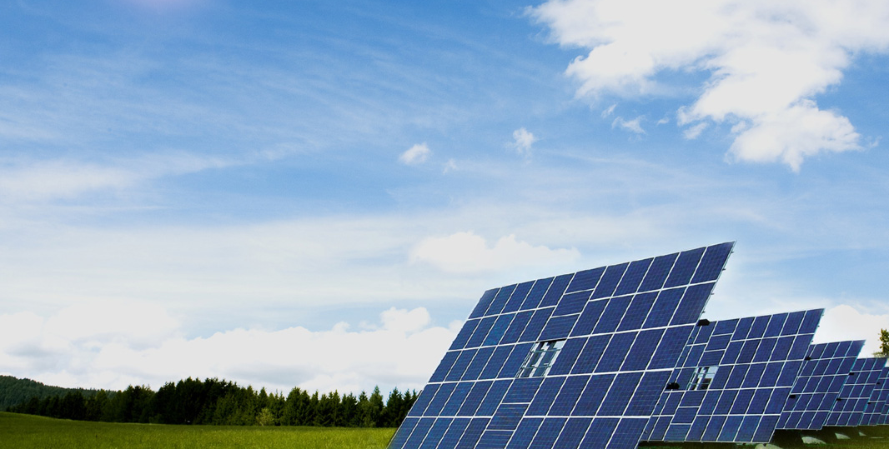
JinkoSolar Holding Co., Ltd.
Q3 2013 Earnings Call Presentation
Nov 18, 2013

Slide 2
Disclaimer
This presentation does not constitute an offer to sell or issue or the solicitation of an offer to buy or acquire securities of JinkoSolar Holding Co., Ltd. (the “Company”) in any jurisdiction or an inducement to enter into investment activity, nor may it or any part of it form the basis of or be relied on in connection with any contract or commitment whatsoever.
The information herein has been prepared by the Company solely for use in this presentation. The information contained in this presentation has not been independently verified. No representation, warranty or undertaking, express or implied, is made as to, and no reliance should be placed on, the fairness, accuracy, completeness or correctness of the information or the opinions contained herein. None of the Company or any of its affiliates, advisors or representatives will be liable (in negligence or otherwise) for any loss howsoever arising from any use of this presentation or its contents or otherwise arising in connection with the presentation.
By attending this presentation, participants agree not to remove this document, or any materials provided in connection herewith, from the conference room where such documents are provided. Participants agree further not to photograph, copy or otherwise reproduce these materials in any form or pass on these materials to any other person for any purpose, during the presentation or while in the conference room. Participants must return this presentation and all others materials provided in connection herewith to the Company at the completion of the presentation.
This presentation may contain forward-looking statements and management may make additional forward-looking statements in response to your questions. These statements are made under the ''safe harbor'' provisions of the U.S. Private Securities Litigation Reform Act of 1995. These forward-looking statements can be identified by terminology such as “will,” “expects,” “anticipates,” “future,” “intends,” “plans,” “believes,” “estimates,” “confident” and similar statements. Statements that are not historical facts, including statements concerning our beliefs, forecasts, estimates and expectations, are forward-looking statements. Forward-looking statements involve inherent risks and uncertainties that could cause actual results to differ materially from those projected or anticipated, including risks related to: the risk that our results of operations may fluctuate from period to period; the risk of PRC governmental policy changes; the risk that we face intense competition from other solar companies; the risk that PRC economic, political and social conditions as well as government policies can affect our business and other risks outlined in our public filings with the Securities and Exchange Commission, including our registration statement on Form F-1, as amended.
The forward-looking statements made in this presentation relate only to events or information as of the date on which the statements are made in this presentation. Except as required by law, we undertake no obligation to update or revise publicly any forward-looking statements, whether as a result of new information, future events or otherwise, after the date on which the statements are made or to reflect the occurrence of unanticipated events.

Slide 3
Financial Highlights and Outlook
 | Q2 2013A | Q3 2013A | Q4 2013E | FY2013E
Capacity (MW) | 1,500 – wafer 1,500 – cell 1,500 – module | 1,500 – wafer 1,500 – cell 1,800 – module | 1,500 – wafer 1,500 – cell 1,800 – module | 1,500 – wafer 1,500 – cell 1,800 – module
Shipments (MW) | 489.2 (44.5% QoQ) | 518.9 （6.1% QoQ） | 500 – 530(module) 108 (operational projects) | 1,700 – 1,800 (module) 210– 230 (operational projects)
Revenues (US$ in millions) | $287.6 (53.6% QoQ) | $320.7 （11.2% QoQ） | - | -
In-house Gross Margin (%) | 18.3% | 21.0% | - | -
Gross Margin (%) | 17.7% | 22.3% | - | -
Diluted Earnings/Loss per ADS (US$) | 0.36 | 0.72 | - | -
1
JinkoSolar defines “in-house gross margin” as the gross margin of PV modules produced using the Company’s in-house produced silicon wafers and solar cells.

Slide 4
Capacity and Shipment
Capacity (MW)
Module Shipments (MW)
As of Sep 30, 2013, the Company’s in-house annual silicon wafer, solar cell and solar module production capacity was approximately 1,500MW, 1,500MW and 1,800 MW separately.
Total solar product shipments in the third quarter of 2013 were 518.9 MW, up 6.1% QoQ.
Q3 solar module shipments were 489.3 MW, up 6.37% QoQ.

Slide 5
Significant Cost per Watt Reduction
In-house Cost | Q4 2012 | Q1 2013 | Q2 2013 | Q3 2013
Mono & Multi Non-Silicon Cost ($/Watt) (Including Depreciation) | $0.45 | $0.42 | $0.41 | $0.41
Mono & Multi Silicon Cost ($/Watt) | $0.09 | $0.09 | $0.09 | $0.09
Total Cost ($/Watt) (Including Depreciation) | $0.54 | $0.51 | $0.5 | $0.5
Non-silicon cost was flat quarter-over-quarter, mainly due to:
Continuous improvements in operating efficiency and technological advancements offset by the increased cost of certain auxiliary materials.
Silicon cost was flat quarter-over-quarter, mainly due to:
The stabilization in the spot price of poly silicon.

Slide 6
Downstream Project List
2013 Project List
Region
Name
Capacity
(MW)
Commercial operation date
105 MW
operating
Qinghai | Delingha Ruiqida | 27 ⁽¹⁾ | Jan 2013
Gansu | Gansu Longchang PV | 20 | Feb 2013
Gansu | Gansu Jintai Electric | 28 ⁽²⁾ | July 2013
Qinghai | Hainan South Zhongzhou PV | 10 | Sept 2013
Xinjiang | Shaya Jingxin | 20 | Oct 2013
Xinjiang | Wusu City Zhongjing PV | 20 | Q4 2013
Xinjiang | Alaer JinkoSolar | 20 | Q4 2013
Gansu | Gansu Jintai Electric II | 28 ⁽²⁾ | Q4 2013
Xinjiang | Bohu Jingjia Sunshine | 20 | Q4 2013
Xinjiang | Shaya Jingxin II | 20 | Q4 2013
Total |  | 213
108 MW
in construction (to come online in Q4 2013)
Additional
300 MW
expected to come online in 2014
(1) Jinko owns 88.7% of the 30 MW project.
(2) Jinko owns 28% of the 100 MW project.

Slide 7
Quarterly Financial Highlights
Total Revenues and Total Shipments
Gross Profit and Gross Margin
Operating Profit and Operating Margin
Net Income/loss, Net Margin and Diluted EPS

Slide 8
P&L Summary
US$ in millions | Q3 2012* | Q3 2012* | Q1 2013* | Q2 2013* | Q3 2013*
Revenues | 211.5 | 187.3 | 187.3 | 287.6 | 320.7
Gross Profit/(loss) | 12.4 | 7.1 | 23.7 | 50.8 | 71.5
Gross Margin | 5.8% | 3.8% | 12.7% | 17.7% | 22.3%
Operating Expenses | 30.1 | 124.8 | 26.4 | 25.4 | 193.3
Operating Margin | (8.4)% | (62.9)% | (-1.4)% | 8.8% | 12.4%
Interest Expense/(Income) | 8.2 | 9.0 | 8.9 | 9.5 | 9.2
Taxes Expense/(Benefit) | 0.2 | 0.01 | 0.002 | 0.035 | 3.0
Net Income | (18.2) | (122.2) | (20.7) | 8.0 | 16.9
Net Margin | (9.8)% | (65.2)% | (11.1)% | 2.8% | 5.3%
Non-GAAP Net Income | (13.9) | (112.3) | (12.1) | 12.1 | 32.2
Non-GAAP Net Margin | (6.6)% | (59.9)% | (6.4)% | 4.2% | 10.0%
2
*(Unaudited)
2. For a discussion of the non-GAAP financial measures used in this release and the reconciliations of the GAAP financial measures to non-GAAP financial measures, please refer to the section below entitled "Use of Non-GAAP Financial Measures" and “Non-GAAP Reconciliation”. JinkoSolar adjusts net income to exclude 1) Gain on changes in fair value of convertible senior notes and capped call options, 2) Interest expenses on the convertible senior notes, and 3) The exchange gain on the convertible senior notes and capped call options.

Slide 9
Balance Sheet
US$ in millions | Q3 2012* | Q4 2012* | Q1 2013* | Q2 2013* | Q3 2013*
Cash and Restricted Cash | 54.9 | 67.4 | 93.0 | 113.2 | 218.7
Accounts Receivable (third parties) | 328.1 | 274.9 | 304.7 | 299.2 | 230.3
Inventories | 135.7 | 84.7 | 119.8 | 86.3 | 102.9
Advances to Suppliers (third parties) | 30.5 | 10.2 | 29.2 | 16.2 | 15.2
Net PP&E | 550.3 | 534.5 | 527.5 | 544.1 | 544.4
Total Assets | 1,441.2 | 1,343.9 | 1570.0 | 1613.0 | 1700.1
Total Debt | 500.0 | 515.2 | 718.7 | 675.0 | 641.5
Short-term Borrowings (incl. current portion of long-term borrowings, and bonds payable) | 390.5 | 410.8 | 397.0 | 386.2 | 330.2
-Long-term Borrowings | 43.8 | 26.8 | 55.4 | 62.4 | 62.6
-Convertible Senior Notes | 65.7 | 77.6 | 84.3 | 91.1 | 110.0
-Bond payables | - | - | 182.0 | 135.3 | 138.7
Total Liabilities | 1,090.9 | 1,123.3 | 1368.7 | 1400.0 | 1399.9
Total Shareholders' Equity | 347.3 | 219.1 | 200.0 | 211.7 | 298.5
*(Unaudited)

Slide 10
Thank you!
www.jinkosolar.com

